Slide 1
PROJECT:
NATURAL DISASTER ANALYSIS
Group 13:
1753037 – Nguyễn Phúc Đăng
1753097 – Lê Nguyễn Minh Tâm

Slide 2
DESCRIPTIONS:
In this project, our group perform an analysis on an EM-DAT natural disasters data set to find these relevant insights:
Country is most impacted by natural disasters by visualize data using Tableau
Short-term prediction of Global's number of Disaster Ocurrence by using Arima

Slide 3
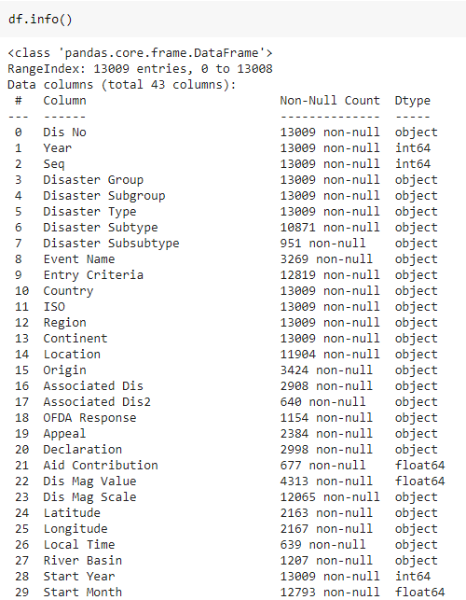
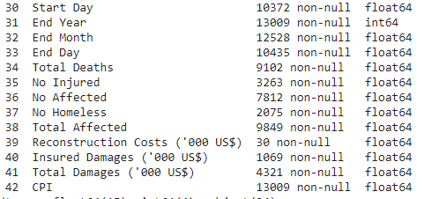
DATA:
In this Project, we using disaster dataset from EM-DAT(https://public.emdat.be/data)
The Dataset contain the information of natural disasters that occur within 1980 and 2019
We drop columns which missing a lots of data and don't really help in this project

Slide 4
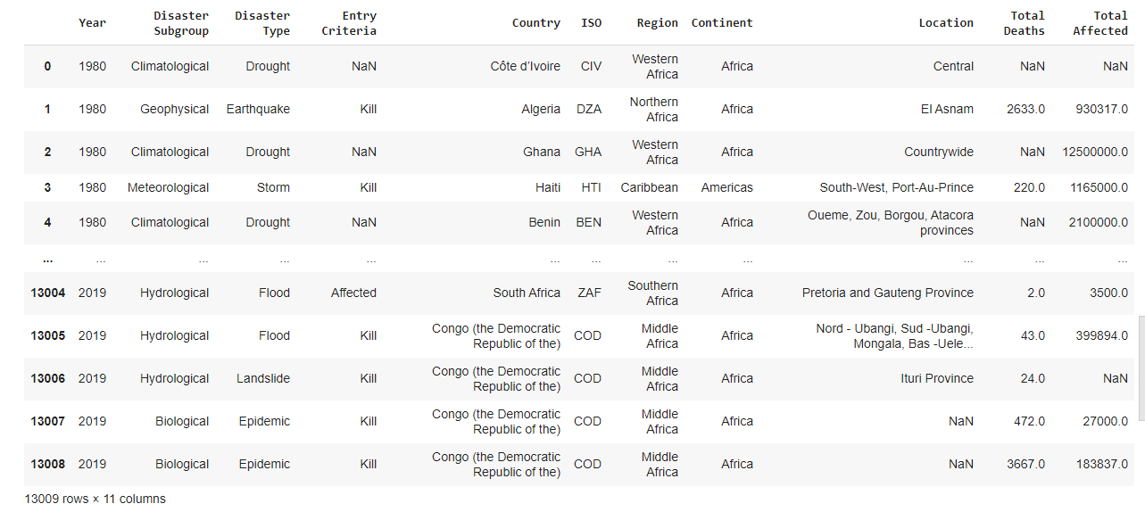
DATA:
Missing Values

Slide 5
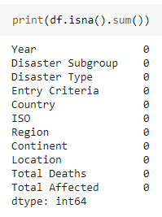
FILL MISSING VALUES:
Fill “Nan” value in “Location” column with “unknown” value
Fill “Nan” value in “Entry Criteria” column:
First, based on “ISO” and “Disaster Type” columns
Second, based on ”ISO” columns
Fill “Nan” value in “Total Deaths” and “Total Affected” columns:
First, based on “ISO” and “Disaster Type” column
Second, based on ”Disaster” columns
Third, based on ”ISO” columns

Slide 6
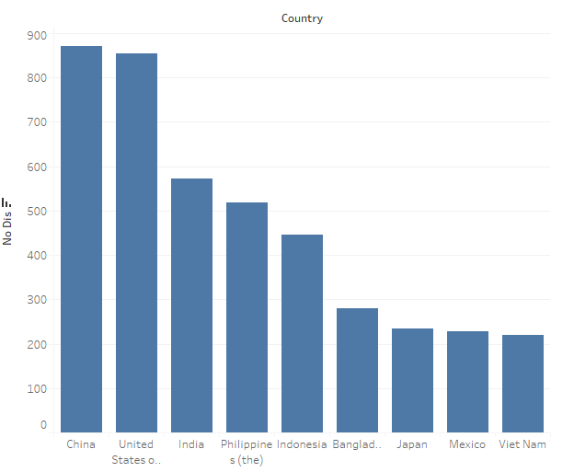
VISUALIZE:
Disasters
From 1980 to 2019: China is the country that suffered the most natural disaster

Slide 7
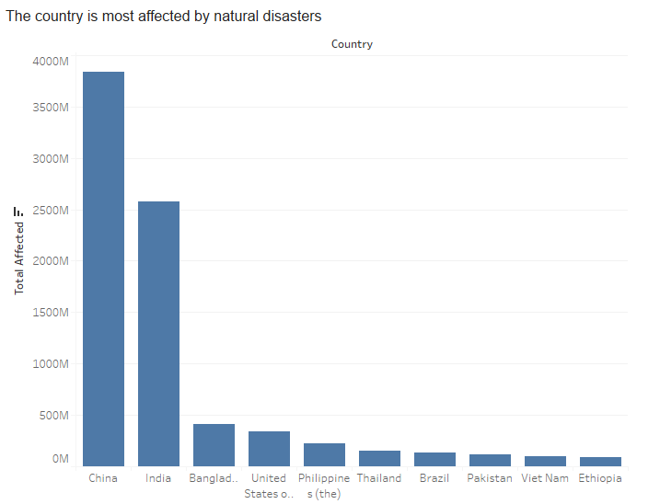
VISUALIZE:
Peoples
From 1980 to 2019: China is the country that is most affected (dead, injured, homeless) by natural disaster

Slide 8
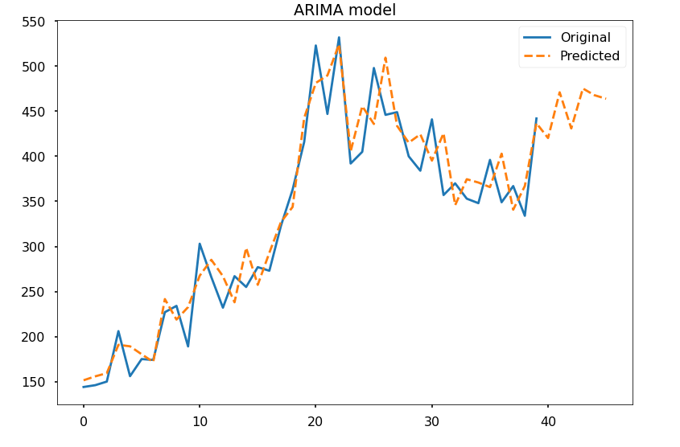
PREDICT SHORT-TERM (6 years):
We use ARIMA model to predict Total disasters will occur in the next 6 years
No Disasters
1980
1990
2000
2010
2020
Year

Slide 9
DEMO

